Slide 1
COMPARISON OF NOVA VIEW® ANTINUCLEAR ANTIBODY TITERS
TO MANUAL FLUORESCENT MICROSCOPY
Susan S. Copple M.S., MT(ASCP)SI
Technical Supervisor Autoimmune Immunology
ARUP Laboratories
Salt Lake City, UT USA
July 22, 2011

Slide 2
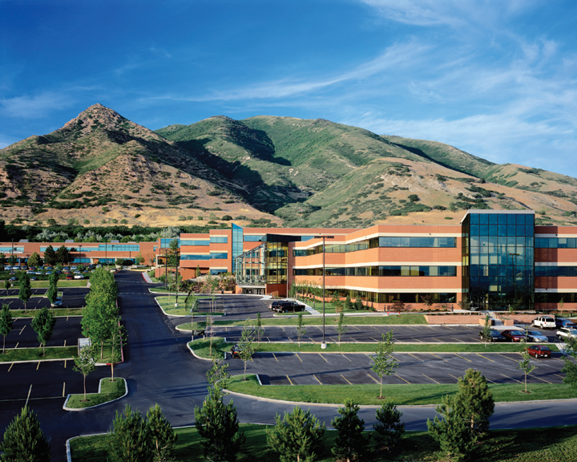
ARUP Laboratories

Slide 3
ARUP Laboratories
Associated Regional University Pathologists
An enterprise of the University of Utah, Department of Pathology
Formed in 1984
A national anatomic and clinical pathology reference laboratory
Serves all 50 states in the U.S.A.

Slide 4
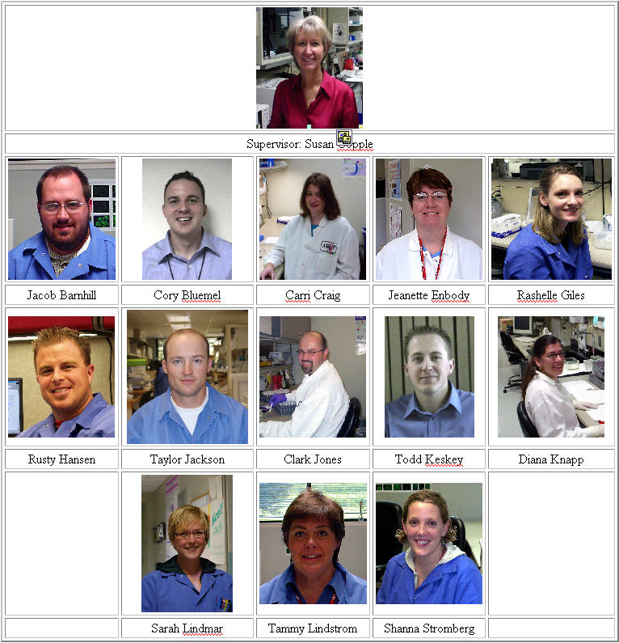
Autoimmune Staff

Slide 5
Description of NOVA View®

Slide 6
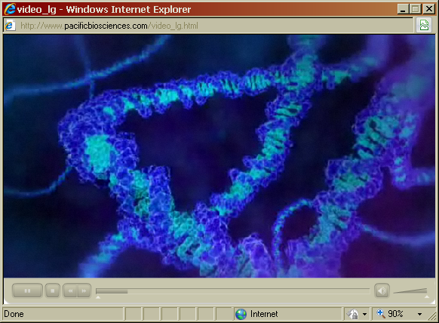
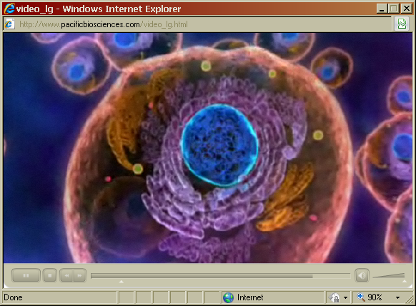
NOVA View is programmed to locate cells
Cells are stained with a blue nuclear stain, DAPI (diamidino-2-phenylindole)
DAPI selectively binds to double stranded DNA
This selectivity stains the nuclei with little background from cytoplasm
DAPI excitation is measured at 455 nm

Slide 7
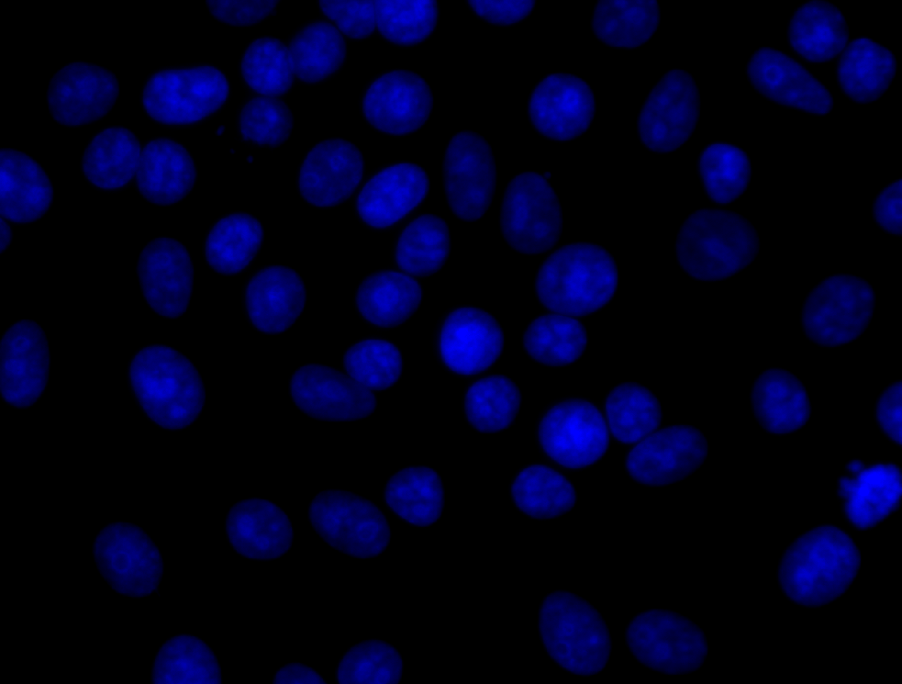
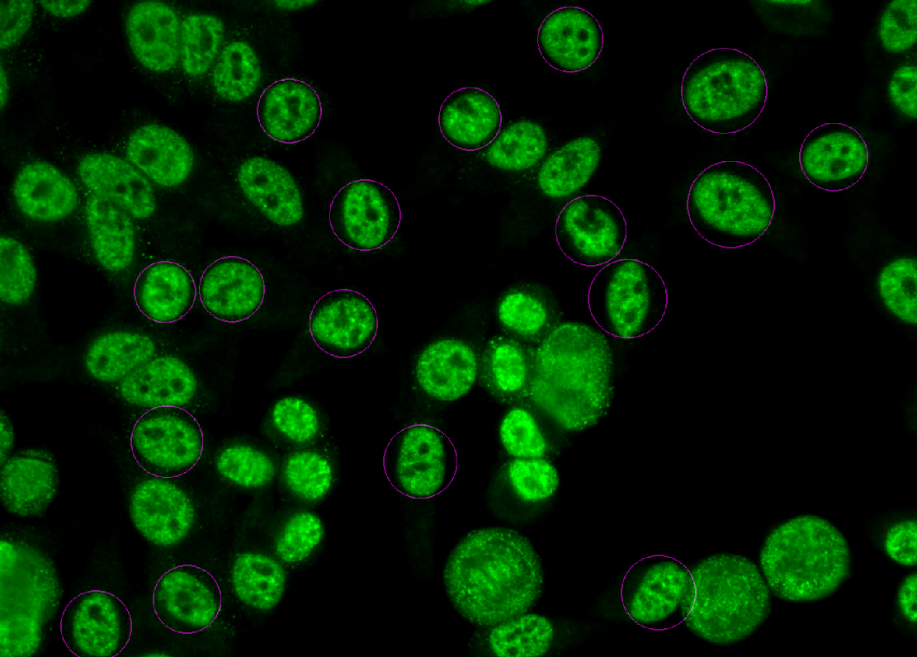
Automatically selects the right cells
100% QC for cells
Pre-programmed to select cells
NOVA View searches for appropriate cell population using DAPI
DAPI stain allows NOVA View to focus on nuclei
After finding ideal well location, NOVA View automatically changes wavelength to 490nm to calculate FITC intensity

Slide 8
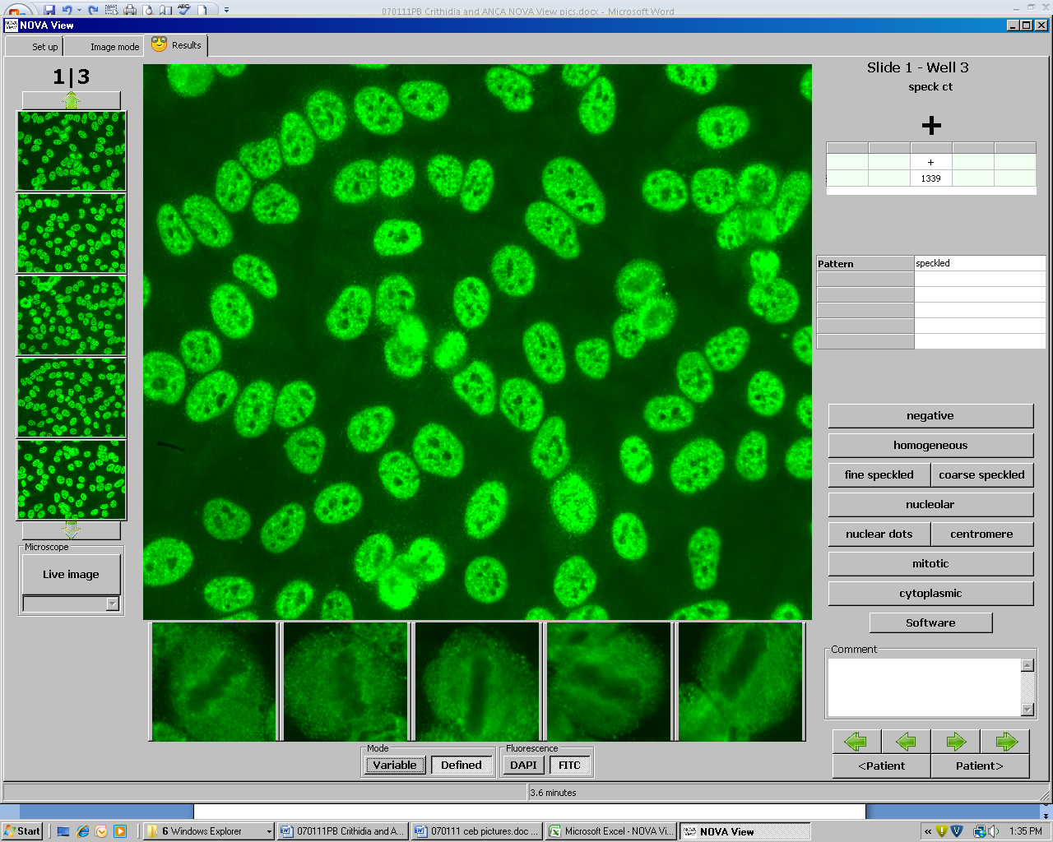
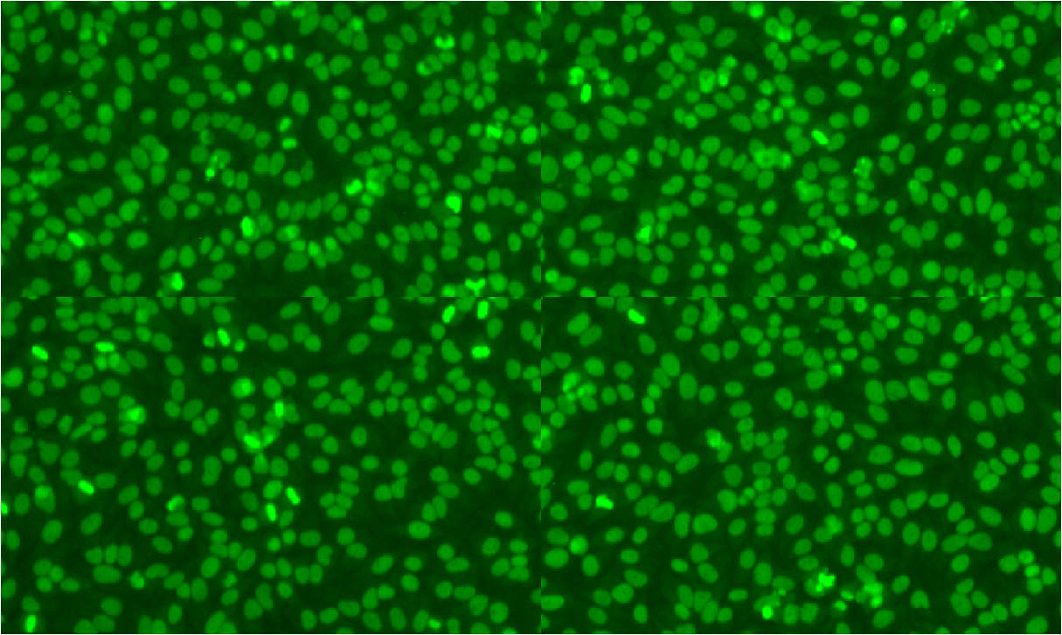
Creates a digital image
1
2
1
2
1
3
4
3
5
5
4
NOVA View scans 5 regions around the center of each well repeating the DAPI/FITC review
A single image is selected from each region for final interpretation
NOVA View displays five images for confirmation and archiving

Slide 9
Confirmation step
Digital images are presented on touch screen for immediate analysis and confirmation
NOVA View provides the following interpretation aids:
  Fluorescent intensity
  Cellular patterns
  Presence of mitotic cells
  Evidence of cytoplasmic staining

Slide 10
Objective of study
To evaluate the performance of the NOVA View® automated IFA microscope when compared to manual viewing of ANA HEp-2 slides by an experienced, certified medical technologist.

Slide 11
Samples
370 well defined sera consisting of:
  44 rheumatoid arthritis
  50 SLE, 35 scleroderma
  20 Sjögren’s syndrome
  10 polymyositis
  99 healthy controls
  12 defined reference sera from the Centers for Disease Control
  100 random patient sera sent to ARUP Laboratories for ANA HEp-2 IFA testing were included

Slide 12
Method
All samples were performed manually using the NOVA Lite® product number here
NOVA View read sera using the beta 1.0.1 software with an Fluorescent Intensity cut off of 100
Manual reading was performed on a Nikon Eclipse 400 at 40x

Slide 13
Interpretation
Samples were read using the NOVA View protocol and compared to results obtained from manual reading with a Nikon Eclipse 400 fluorescent microscope fitted with an LED light source
Agreement was determined when the interpretation from NOVA View and manual reading were within one double dilution

Slide 14
Results
Overall agreement of 98% was demonstrated
Negative sera: 100% agreement
Positive sera: 97% agreement
Patterns demonstrated 97% agreement
PCNA and mixed patterns produced a positive intensity unit with an undetermined pattern on NOVA View

Slide 15
Example of ANA Endpoint Titrations
Notes:
I will discuss how the NV reads comparable to another technologist except that the NV will be consistent where a person can vary day to day.

Slide 16
Conclusions
NOVA View demonstrated excellent agreement with manual IFA.
Validating an intensity cut off for the NOVA View would decrease turn-around time for negative sera.
The NOVA View had difficulty producing the same pattern on all dilutions in only 0.005% of the samples.
Mixed or difficult patterns are designated as positive by NOVA View and can be easily viewed by the technologist for interpretation
The NOVA View instrument demonstrates excellent agreement, 97% to 100%, with manual fluorescent microscopy

Slide 17
ANA Titration Conclusions
NOVA View is comparable to the technologists
All titers were within plus or minus one doubling dilution
DAPI/FITC conjugate used on slides with NOVA View is comparable to the regular IgG specific conjugate
Titers could be run on NOVA View now
NOVA View provided consistency. Technologists are prone to eye strain

Slide 18
Observed Advantages
Ease of use
Archived Images can be reviewed at any time. Can be sent to the physician at their request
Training: new technologists can be trained viewing the same image as the instructor, at the same time
Education: unusual patterns can be reviewed by multiple people for education purposes and stored in the Atlas
Consistency of reading, a selling point. Eye fatigue, reader bias
Interface saves time and reduces transcription errors
Versatility: in clinical work, training, investigating problems

Slide 19

We continue to challenge the limits
Angel’s Landing, Zion National Park

